Slide 1
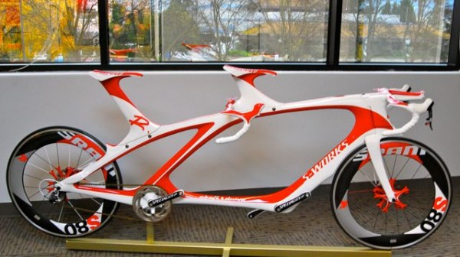
Specialized Machine Learning Topics Lantz Ch 12
Wk 6, Part 2
Above – Specialized bicycle – a tandem track bike. Note that the seats are not adjustable, and there are no brakes.
Notes:
Image from http://www.bikerumor.com/2009/12/30/specialized-shiv-carbon-fiber-tandem-aka-the-supersonic-divorce-machine/

Slide 2
All the things you may need to know – sometime!
There are packages to convert various kinds of data in and out of R, like:
Web scraping
XML
JSON
Excel
Bioinformatics
Social network data
Graph data

Slide 3
And there are performance tools
Making dataframes faster for subsetting, joining, and grouping
Creating disk-based dataframes
Using massive matrices
Using parallel computing and multitasking
Cloud computing with MapReduce and Hadoop
Run R on your graphics card!
Build big regression models and random forests

